Slide 1
Pure Sounds (ruthmiskin.com)
Read Write Inc Phonics: How to say the Set 1, Set 2 and Set 3 sounds
Notes:
We teach using pure sounds.
We pronounce the sounds clearly, using pure sounds (‘m’ not’ muh’, ’s’ not ‘suh’, etc.) so that your child will be able to blend the sounds together to make words more easily.
You can watch this film of little Sylvie on the Ruth Miskin website to practise using pure sounds. Play a little bit of the video.

Slide 2
Parents’ Meeting
Introduction to Read Write Inc.
Notes:
Approximately 20 minutes is needed for this session.
Notes are provided to help you lead the presentation.
Notes in italics are for your attention only.
This bitesize parent session is designed as an introduction to Read Write Inc when you first implement the programme in your school and for parents of new YR children each September.
Use the other bitesize parent PPTs throughout the year to discuss and practise how they can help their child at home based on the child’s group.
Notes are provided to help you lead the presentation.
Notes in italics are for your attention only.
Provide copies of ‘Reading at Home Booklet 1 or 2’ from Oxford Owl.
Booklet 1 is sound groups and Ditty/ Red Groups and Booklet 2 for Green – Grey Storybooks.

Slide 3
Reading changes everything
Teach a child to read and keep that child reading and we will change everything.
And I mean everything.
Jeanette Winterson
Notes:
Read quote.
This is what we do in our school.
Research shows that children who learn to read quickly go on to succeed in school and in life.
Today I want to help you understand how your child is learning to read with phonics – specifically ‘Read Write Inc.’ Phonics.

Slide 4
Why is reading important?
Children that are read to daily by age five may hear about 300,000 words, while those read to five times a day could hear over 1.4 million, creating a significant "million-word gap" compared to children who are never read to, who hear around 4,662 words. This vocabulary difference highlights the importance of reading to children for language and cognitive development.
Notes:
Read quote.
This is what we do in our school.
Research shows that children who learn to read quickly go on to succeed in school and in life.
Today I want to help you understand how your child is learning to read with phonics – specifically ‘Read Write Inc.’ Phonics.

Slide 5
What is Phonics?
https://schools.ruthmiskin.com/training/view/kx3x7Otx/gA0ETmj5

Slide 6
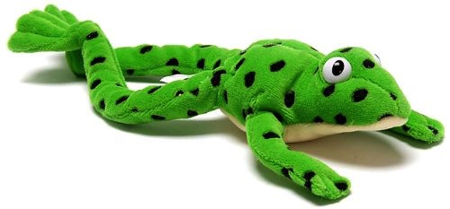
Fred
Notes:
Let me introduce you to Fred.
Fred can only speak in sounds. He says d-o-g, h-a-t etc.
Speaking like Fred helps children to understand that words are made up of sounds.
Fred helps children practise blending sounds together because he needs the children to say the words for him. Fred says d-o-g, children tell him the word is dog.
This is how we quickly teach all of our children to blend.

Slide 7
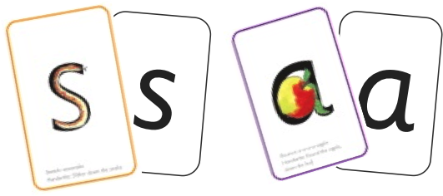

Sounds + blending = reading
+
Notes:
Alongside teaching children sounds, we teach them to blend sounds to read words e.g. s-a-t, sat.
We use Fred Talk to help children read.

Slide 8

Teach spelling using Fred Fingers
Notes:
We use Fred Fingers to help children sound out words to spell easily.
It means they do not have to memorise lists of spelling words.
It is a tool so they will be able to spell any word.

Slide 9
RWI – How it works
https://schools.ruthmiskin.com/training/view/g3jijlKt/kBCGbB5T

Slide 10
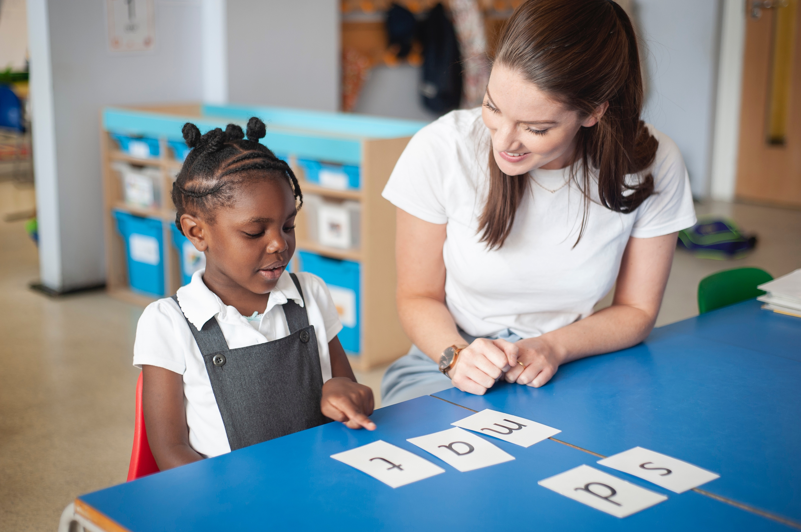
One-to-one tutoring – ‘keep up, not catch up!’
Notes:
We want to make sure every child learns to read in our school.
Some children need extra practice when learning to read so we teach these children one-to-one for ten minutes every day – on top of their group lesson.
We make sure they ‘keep up’ from the beginning and don’t need ‘catch up’ later on.

Slide 11
‘Three with me, four at home’
Accuracy
Fluency
Comprehension
Read and enjoy at home
Notes:
In our school, children read each Read Write Inc. Storybook three times in class with their partner.
Re-reading the same book helps children to become confident readers. Each time they re-read, they build their fluency/speed and comprehension.
They love reading and want to read because they can read all of the words in the Storybook.
We set a focus for each re-read in school.
(Click) The first read focuses on reading every word accurately.
(Click) The second on reading the story more quickly.
(Click) The third read on comprehension - understanding what they read.
Then your child brings the same book home to read and enjoy with you again and again at home.
It’s ‘three with me, four at home.’
We do not send stories home the children cannot read because we always want them to be set up to succeed in their reading.
We want to make sure they enjoy reading so that they want to read.
The more they read, the faster progress they will make.

Slide 12
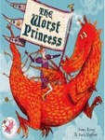
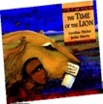



Which books will children bring home?
+
+
Notes:
In your child’s book bag, they will bring home:
the Storybook they have read in class to practise reading what they can already read.
The children enjoy re-reading stories they know well. Their fluency improves on every reading.
- A Book Bag Book.They have guidance inside just for you as parents., They are matched to the books children read in school so provide practice of the same sounds – extra practice at the right level for your child. They include many of the same reading activities that we use in class.
A Library book to share with your child to promote the love of reading. You can read the story to them or they can retell the story by looking at the pictures. They are not expected to read the story themselves.

Slide 13
Reading for Pleasure!
Learn to read – read to learn!
Library books from school are for you to enjoying reading together.
Notes:
In your child’s book bag, they will bring home:
the Storybook they have read in class to practise reading what they can already read.
if applicable a ‘Last and past’ Storybook – a previously read RWI Storybooks for extra practice. The children enjoy re-reading stories they know well. Their fluency improves on every reading.
- if applicable a Book Bag Book.They have guidance inside just for you as parents., They are matched to the books children read in school so provide practice of the same sounds – extra practice at the right level for your child. They include many of the same reading activities that we use in class.
A Library book to share with your child to promote the love of reading. You can read the story to them or they can retell the story by looking at the pictures. They are not expected to read the story themselves.
We make sure that every book that goes into your child’s book bag is a well-loved book – one they know already and want to read again and again.

Slide 14
What can I do?
Use pure sounds, not letter names
Use Fred Talk to read and spell words
Listen to your child at least 3 times a week
Read stories to your child every day – bedtime is a great time to share stories
Notes:
We will run regular bitesize meetings to look at each of these in more detail.
Provide copies of ‘Reading at Home Booklet 1 or 2’ from Oxford Owl.
Booklet 1 is sound groups and Ditty/ Red Groups and Booklet 2 for Green – Grey Storybooks.

Slide 15
Online resources available
Ruth Miskin Parents’ Page:
http://www.ruthmiskin.com/en/parents/
Ruth Miskin Facebook:
https://www.facebook.com/miskin.education

Slide 16
Reading feeds the imagination, it expands
horizons and offers new and exciting ways of
seeing and making sense of our lives and of
the world around us.
Michael Morpurgo
Notes:
Remember that all parents have the power to change outcomes for their children.

Slide 17
Any other questions
Q&A

